Slide 1


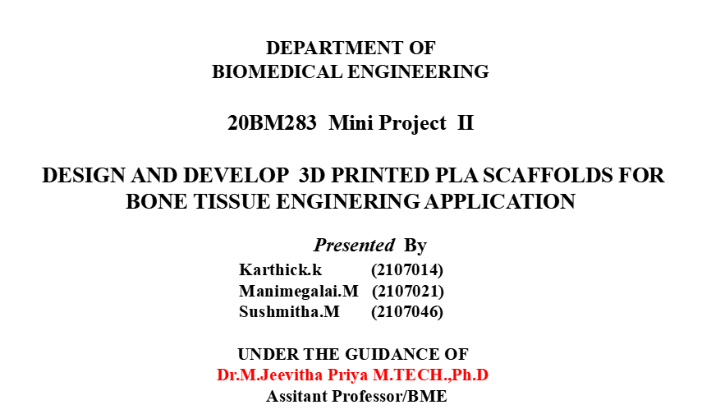
SRI RAMAKRISHNA ENGINEERING COLLEGE
[Educational Service: SNR Sons Charitable Trust]
[Autonomous Institution, Reaccredited by NAAC with ‘A+’ Grade]
[Approved by AICTE and Permanently Affiliated to Anna University, Chennai]
[ISO 9001:2015 Certified and all eligible programmes Accredited by NBA]
VATTAMALAIPALAYAM, N.G.G.O. COLONY POST, COIMBATORE – 641 022.
20BM283 - Mini project II

Slide 2

CONTENTS
Aim and Objectives
Literature survey
Existing and Proposed Methodology
Previous Work
Software Specification
Results and Discussion
Conclusion and Future Scope
Reference
20BM283 - Mini project II

Slide 3
AIM
To design and develop 3D printed scaffolds using different characterization methods for bone tissue engineering application.
OBJECTIVES
To design and develop 3D printed scaffolds for bone tissue engineering application.
SUB OBJECTIVE:
  To design and print the 3D printed scaffold(completed)
      Design 3D model using solidworks software
      Print designed model using ULTIMAKER 2 (FDM)printer
  To Characterize the 3D Printed Scaffold
      In silico analysis (Ansys ,Comsol)
      Core analysis of the structure by SEM and XRD
  To test the printed scaffold by in vitro studies
      Antimicrobial testing of the printed scaffold
      Cytotoxicity on bone cells
20BM283 - Mini project II

Slide 4
LITERATURE SURVEY
S. No | TITLE | AUTHOR | NAME OF ORGANIZATION &YEAR | DESCRIPTION
1. | A Combined Computational and Experimental Analysis of PLA and PCL Hybrid Nanocomposites 3D Printed Scaffolds for Bone Regeneration | SpyrosV. Kallivokas,Lykourgos C. Kontaxis Spyridon Psarras. | MDPI on Jan,2024. | In this research, combined experimental and computational approaches were used to study and compare mechanical parameters. Overall, a holistic approach was utilized to achieve a delicate balance between structural robustness and optimal fluidic conditions.
2. | Degradation of 3D-Printed Porous Polylactic Acid Scaffolds Under Mechanical Stimulus | Heming Chen,Quan Shi ,Hengtao Peng Wang,Qiang Chen1,Zhiyong Li | Frontiers on oct, 2021. | In this study, the degradation of a 3D-printed porous PLA scaffold under mechanical stimulus was studied by combining the in vitro experiments with the numerical simulations.
20BM283 - Mini project II

Slide 5
Conti..
5. | Design of 3D printed scaffolds for bone tissue engineering | Susheem Kanwar | MDPI-2021 | The 3D Printed Scaffolds act as an extra cellular matrix(ECM) providing a 3D environment for cell adhesion proliferation, differentiation. Designing the scaffolds with desired parameters such as biodegradability has led to further computational analysis.
6. | 3D Bioactive composite scaffolds for bone tissue engineering | Gareth Turnbull | MDPI-2022 | The 3D Printed Scaffolds act as an extra cellular matrix(ECM) providing a 3D environment for cell adhesion proliferation, differentiation. Designing the scaffolds with desired parameters such as biodegradability has led to further computational analysis.
7. | Additive manufacturing of PLA-based scaffolds intended for bone regeneration and strategies to improve their biological properties | Donate, Ricardo, Monzón, Mario and Alemán-Domínguez, María Elena. | Science Direct-2020 | This study contains a description of the specific requirements in the regeneration of bone and how the state of the art have tried to address them with different strategies to develop PLA-based scaffolds by AM techniques and with improved bio functionality.
20BM283 - Mini project II

Slide 6
EXISTING AND PROPOSED METHODOLOGY
EXISTING METHODOLOGY
PROPOSED METHODOLOGY
PLA and its copolymers had been used in wound management such as surgical sutures, healing dental extraction wounds, and preventing postoperative adhesions.
The conventional methods are fabricating the scaffold: solvent casting,particle leaching ,freeze-drying ,gas foaming,Electrospining
The degradation of PLA is from hydrolysis, in which it releases lactic acid monomers that are not toxic.
The compounds of PLA are present in the human body and are removed by natural metabolic pathways.
Dimension of the scaffold model:6.3*3.9*6.3mm and pore size of 700µm and pore spacing of 1mm.
3D printing fabrication technic will be used for printing the scaffold.
    Fused Deposition Modeling (FDM): Extrudes melted biomaterial through a nozzle, layer by layer, to build a scaffold based on a computer-aided design (CAD) model.
20BM283 - Mini project II

Slide 7
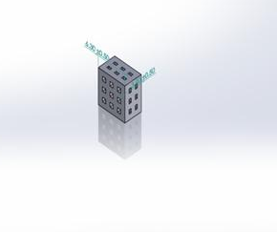
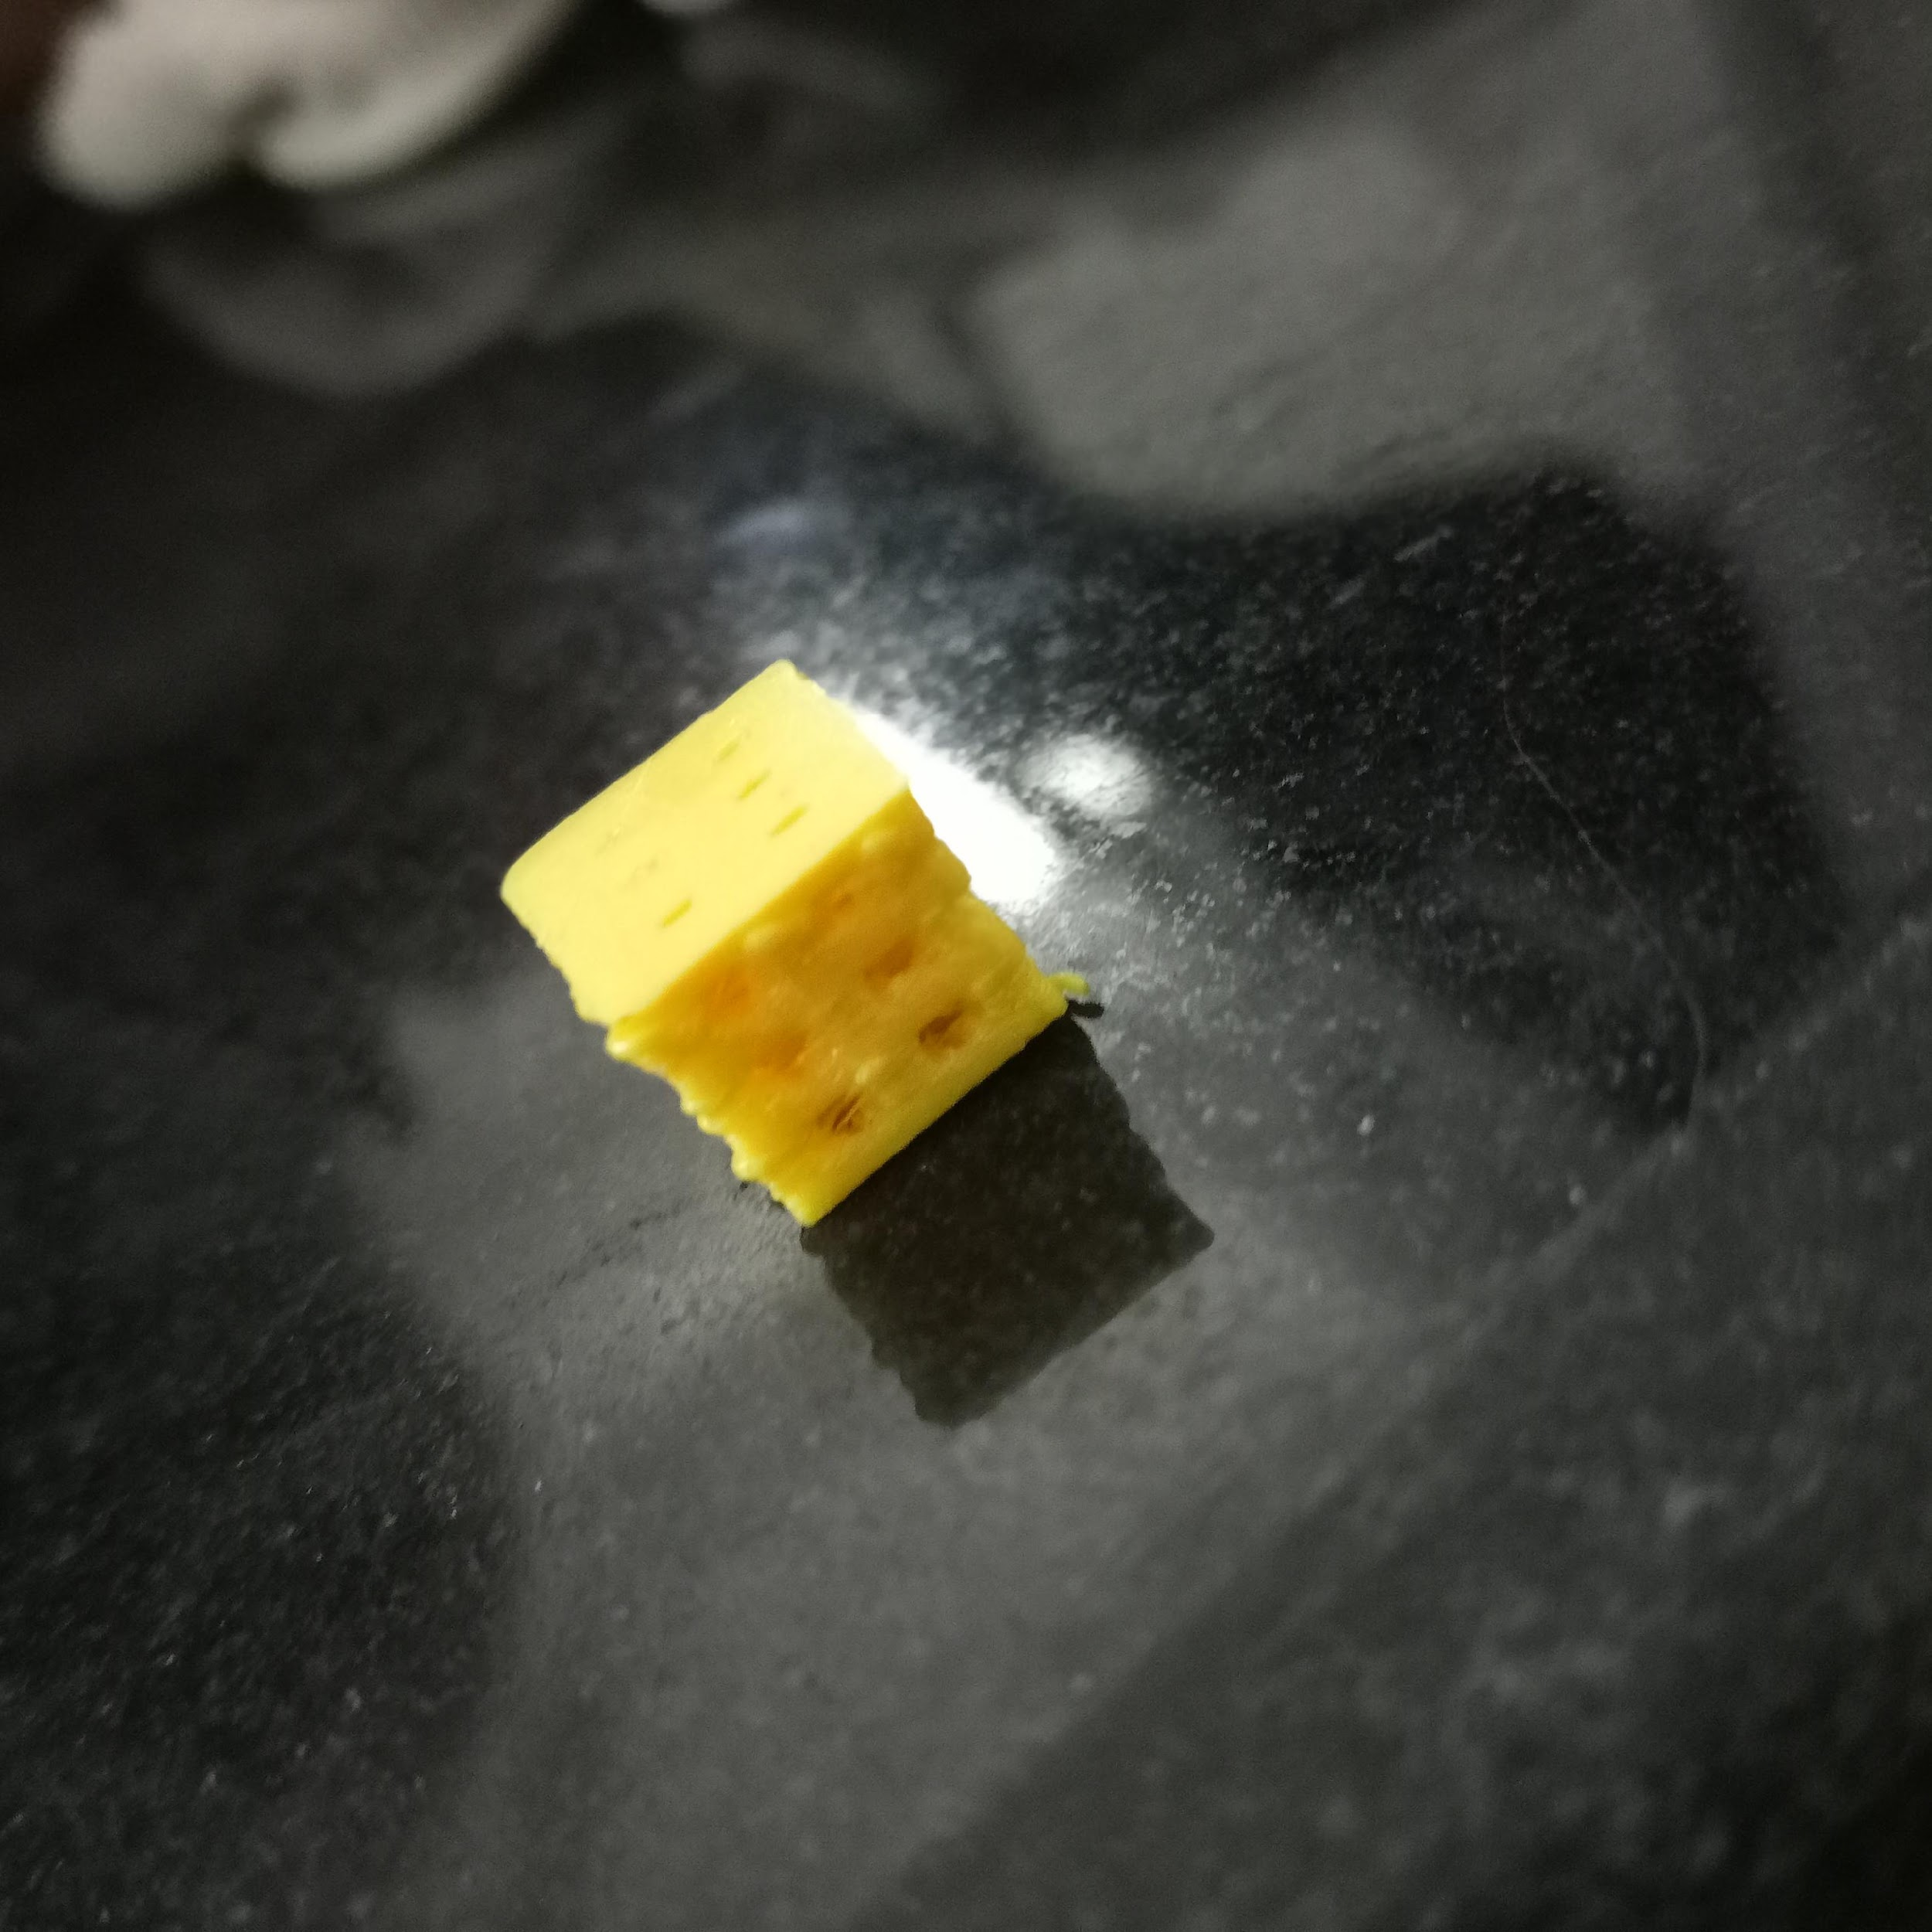
PREVIOUS WORK
Material selection
PLA
(poly lactic acid)
RESULTS
Reviewof literature
Printing Mehodology
FDM Printing
Designing of the porous scaffold
Using Solid works software
Figure 1. Designed model using solidworks
3D printing of scaffold design model
Ultimaker 2 FDM 3D printer used for printing the scaffold
Figure 2. 3D Printed scaffold
4

Slide 8
SOFTWARE SPECIFICATIONS
Software Specification:
Software | Description
ANSYS Work bench | Version 2024 R1
COMSOL | Version 4.1
20BM283 - Mini project II

Slide 9
RESULTS AND DISCUSSION
20BM283 - Mini project II

Slide 12
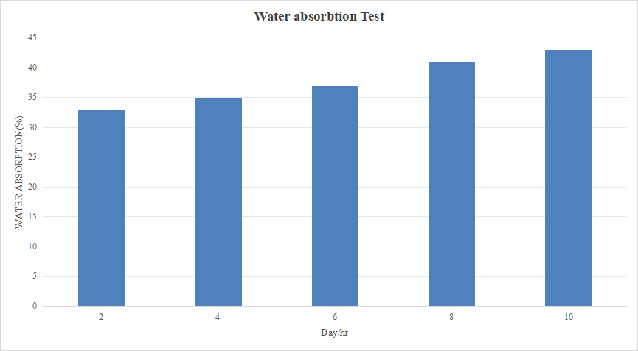

Slide 15
CONCLUSION AND FUTURE SCOPE
In this project, we can done through the different characterization procedures that will used to asses the biocompatibility and performance, evaluation was carried out to analyze scaffold physical, mechanical, and biological properties.
The scaffold showed excellent results in pore size distribution, porosity, and mechanical strength demonstrated and it has a favorable properties for tissue regeneration.
20BM283 - Mini project II

Slide 16
REFERENCES
Senthil Maharaj Kennedy et al.,(2023),”Experimental and finite element analysis on the effect of pores on bio-printed polycaprolactone bone scaffolds https://doi.org/10.1016/j.bprint.2023.e00301.
Senatov et al.,(2020) "Mechanical properties and shape memory effect of 3D-printed PLA-based porous scaffolds”.
Ziqi Guo et al.,(2019), “Characterization of biodegradable poly(lactic acid) porous scaffolds prepared using selective enzymatic degradation for tissue engineering”.
Osman et al.,(2022), "Development and Characterization of Functional Polylactic Acid/Chitosan Porous Scaffolds for Bone Tissue Engineering." Polymers 14, no. 23 (2022): 5079.
R. Baptista et al.,(2022),“Morphological and mechanical characterization of 3D printed PLA scaffolds with controlled porosity for trabecular bone tissue replacement”.
Rushabh Patel .etal.,“Deformation behavior of porous PHBV scaffold in compression: A finite element analysis study”2019.https://doi.org/10.1016/j.jmbbm.2019.04.030
Chen, Heming et al.,(2019), "Degradation of 3D-printed porous polylactic acid scaffolds under mechanical stimulus." Frontiers in Bioengineering and Biotechnology 9 (2021): 691834.
Seyed-Iman Roohani-Esfahani,et al., June 2023 “Design and Fabrication of 3D printed Scaffolds with a Mechanical Strength Comparable to Cortical Bone to Repair Large Bone Defects” Med. 9, 66–76.
Rushabh Patel .etal.,“Deformation behavior of porous PHBV scaffold in compression: A finite element analysis study”2019.https://doi.org/10.1016/j.jmbbm.2019.04.030
20BM283 - Mini project II

Slide 17
THANK YOU
20BM283 - Mini project II

